Slide 1

An Overview of IRIS and IRIS Data Services
TIM AHERN, DIRECTOR, IRIS DATA SERVICES
Training in Network Management Systems and Analytical Tools for Seismology • 23–27 October 2017 • Baku, Azerbaijan

Slide 2
IRIS
facilitates seismological research
Installs and operates the infrastructure needed by earth scientists to understand the complex Earth.
Supports facilities in permanent networks, portable networks and data management services.
A healthy education and public outreach capability
Training in Network Management Systems and Analytical Tools for Seismology • 23–27 October 2017 • Baku, Azerbaijan

Slide 3
Overview: What is IRIS?
Consortium of 125 US Universities and ~125 foreign affiliates
National Science Foundation Funded
  US$25 million annual funding under the SAGE award
Five Programs
  GSN
    ~160 permanent stations
  PASSCAL
    6,483 data loggers with 15,249 recording channel capacity
  Transportable Array now in Alaska
    239 total stations
    150 TA stations
  EPO
    Workshops, posters, museum displays
  Data Services
    >35,000 stations over 45 years
    450 terabyte archive of waveform data
    Archives 75 terabytes per year
    Distributes more than 1 petabyte per year
Training in Network Management Systems and Analytical Tools for Seismology • 23–27 October 2017 • Baku, Azerbaijan

Slide 4
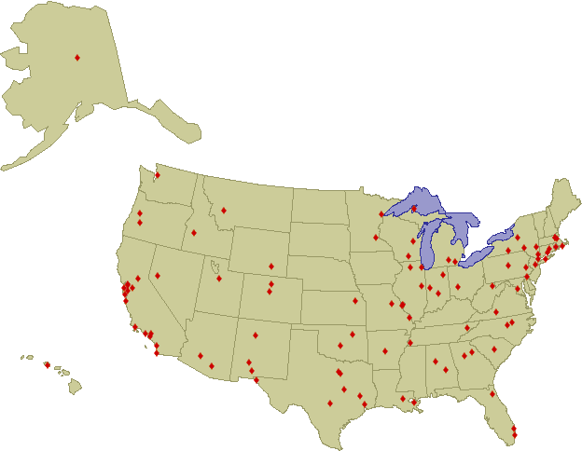
The IRIS Membership
125 Full Member Institutions
Training in Network Management Systems and Analytical Tools for Seismology • 23–27 October 2017 • Baku, Azerbaijan

Slide 5
IRIS
Facilities are open to seismologists worldwide
  Free of charge
  Open Data Policy
Talk to IRIS Staff if you have specific questions
Training in Network Management Systems and Analytical Tools for Seismology • 23–27 October 2017 • Baku, Azerbaijan

Slide 6
IRIS Data Services
Ingestion
  Real time methods
  Bulk file transfer methods
Archiving and Curation
Distribution
Training in Network Management Systems and Analytical Tools for Seismology • 23–27 October 2017 • Baku, Azerbaijan

Slide 7
IRIS Data Services - ingestion
Ingestion
  Real time methods rely on BUD
    SeedLink is our preferred method
    Antelope Orb2Orb
    RRP
    CD1.0 and CD1.1
    And a variety of others
  Bulk file transfer methods
    Mseed2dmc
  Data Provider Agreement shows articulates the responsibilities of network contirbutors and IRIS Data Services
Training in Network Management Systems and Analytical Tools for Seismology • 23–27 October 2017 • Baku, Azerbaijan

Slide 8
Data Services Data Sources
5 decades
208 permanent networks
569 temporary deployments
NSF
Sources
Other
Sources
GSN
3
TB/yr
22
TB/yr
Regional Nets
PASSCAL
13
TB/yr
IRIS
DMC/ADC
9
TB/yr
FDSN
TA
5
TB/yr
~71
TB/yr
6
TB/yr
Non-FDSN
OBSIP
variable
Training in Network Management Systems and Analytical Tools for Seismology • 23–27 October 2017 • Baku, Azerbaijan

Slide 9
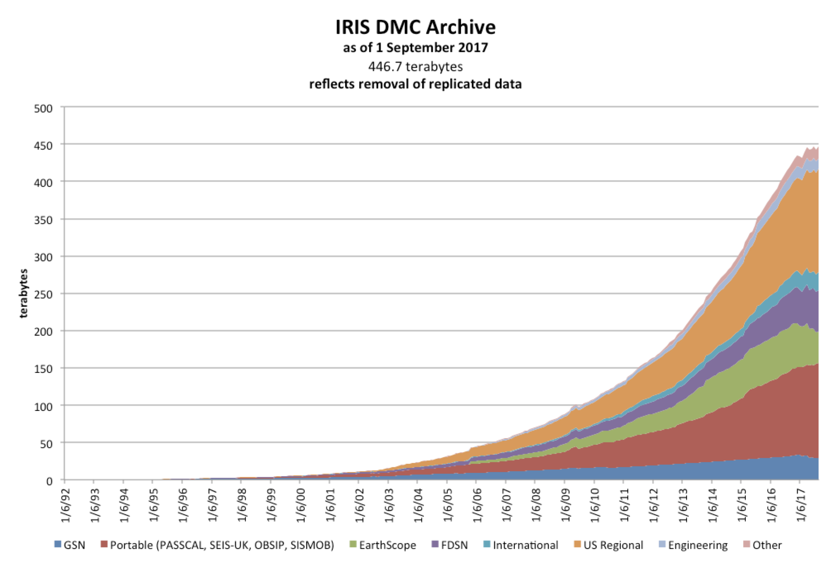
IRIS Data Services - ingestion
Training in Network Management Systems and Analytical Tools for Seismology • 23–27 October 2017 • Baku, Azerbaijan

Slide 10
Archiving and curation
Training in Network Management Systems and Analytical Tools for Seismology • 23–27 October 2017 • Baku, Azerbaijan

Slide 11
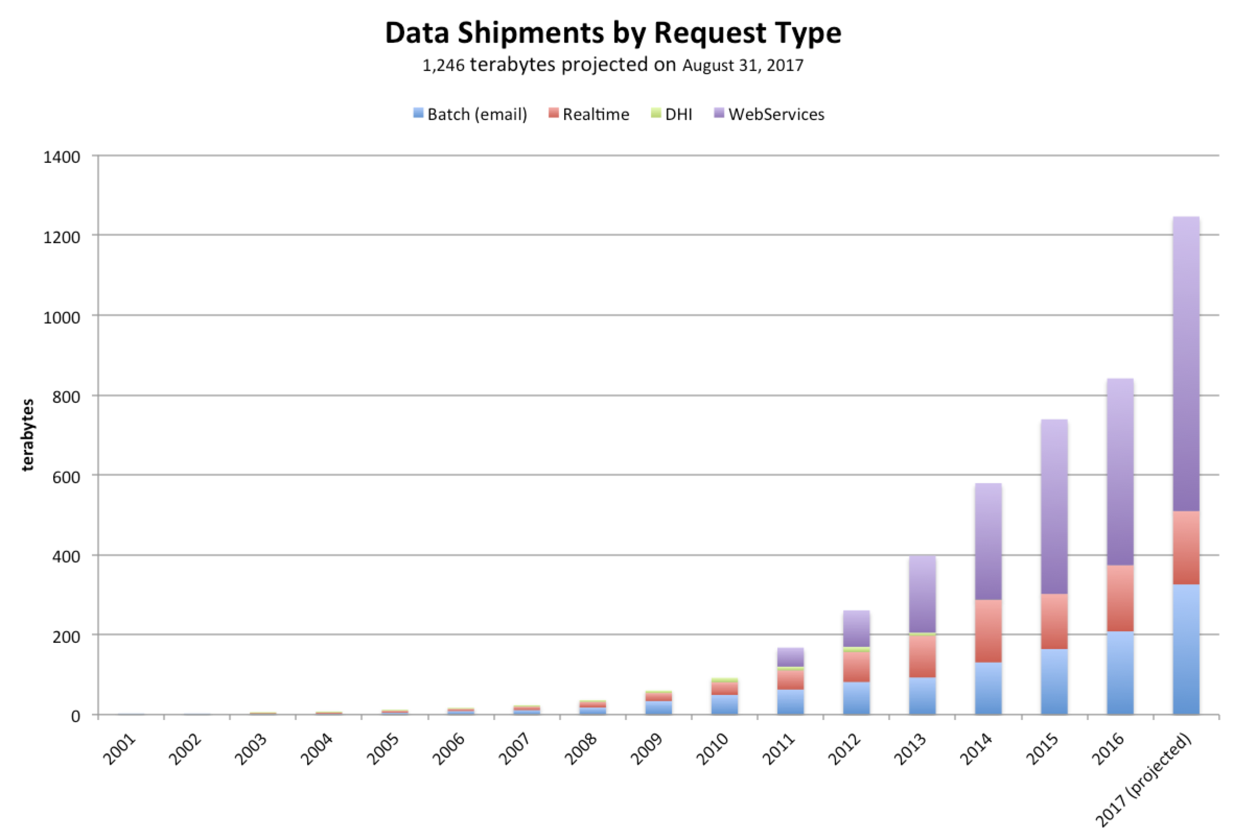
IRIS Data Services - distribution
Training in Network Management Systems and Analytical Tools for Seismology • 23–27 October 2017 • Baku, Azerbaijan

Slide 12
IRIS DS
International Activities
Data Workshops
  A total of ten workshops
Regional Exchange of Earthquake Data (REED)
Support for SeisComp3
  Included FDSN web services support
Training in Network Management Systems and Analytical Tools for Seismology • 23–27 October 2017 • Baku, Azerbaijan

Slide 13
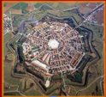
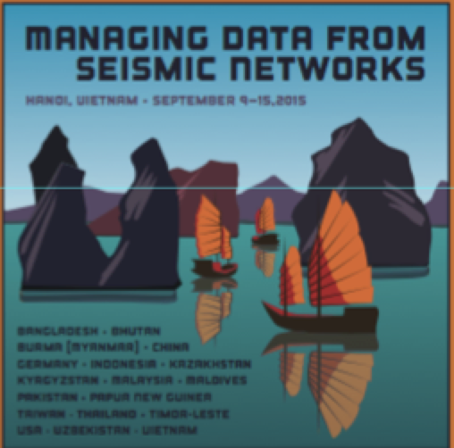





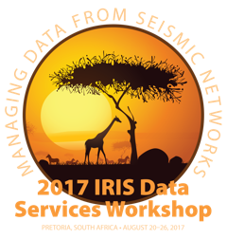
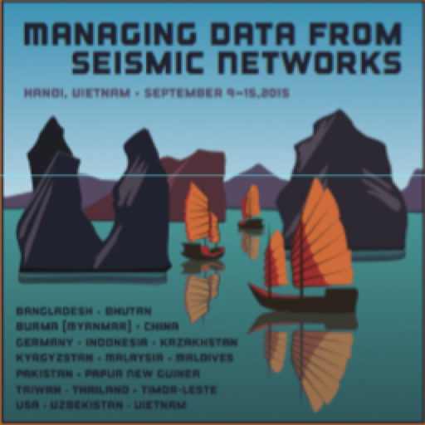
Palmanova
Italy (2005)
Managing Data from Seismic Networks
There have been 10 Data Workshops
Palmanova
Italy (2005)
Sao Paulo
Brazil (2006)
Foz do Iguaçu
Brazil
(2010)
Bangkok
Thailand
(2012)
Petaling Jaya
Malaysia (2007)
Giza
Egypt (2009)
Kuwait City
Kuwai
(2013)
Bogota
Colombia (2014)
Hanoi Vietnam (2015)
Training in Network Management Systems and Analytical Tools for Seismology • 23–27 October 2017 • Baku, Azerbaijan

Slide 14
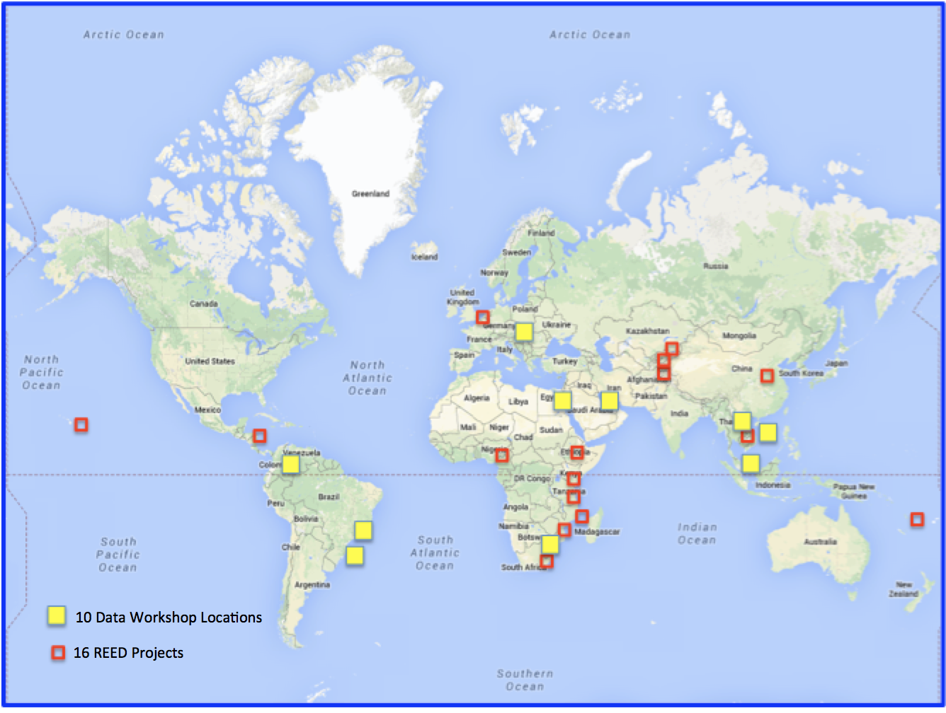
Workshops and REED Projects
Training in Network Management Systems and Analytical Tools for Seismology • 23–27 October 2017 • Baku, Azerbaijan

Slide 15

Thank you!
Training in Network Management Systems and Analytical Tools for Seismology • 23–27 October 2017 • Baku, Azerbaijan

